Slide 1
Data Mining (CSE 6506)
Association Rule Mining (ARM)
Mahmuda Naznin
Department of Computer Science Engineering, BUET

Slide 2
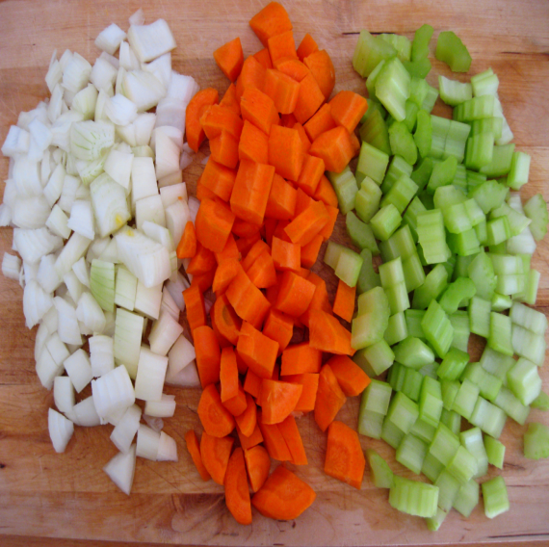
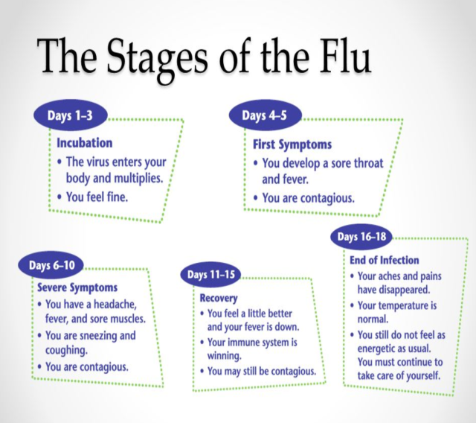
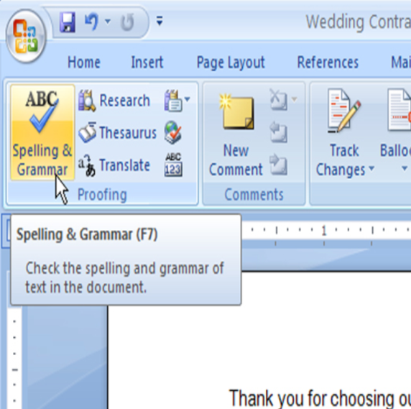
What Are Patterns?
What are patterns?
Patterns: A set of items, subsequences, or substructures that occur frequently together (or strongly correlated) in a data set
Patterns represent intrinsic and important properties of datasets
Frequent item set
Frequent sequences
Frequent structures
Notes:
https://culinspiration.files.wordpress.com/2010/03/img_3955.jpg
http://slideplayer.com/slide/6292417/21/images/65/The+Stages+of+the+Flu.jpg

Slide 3
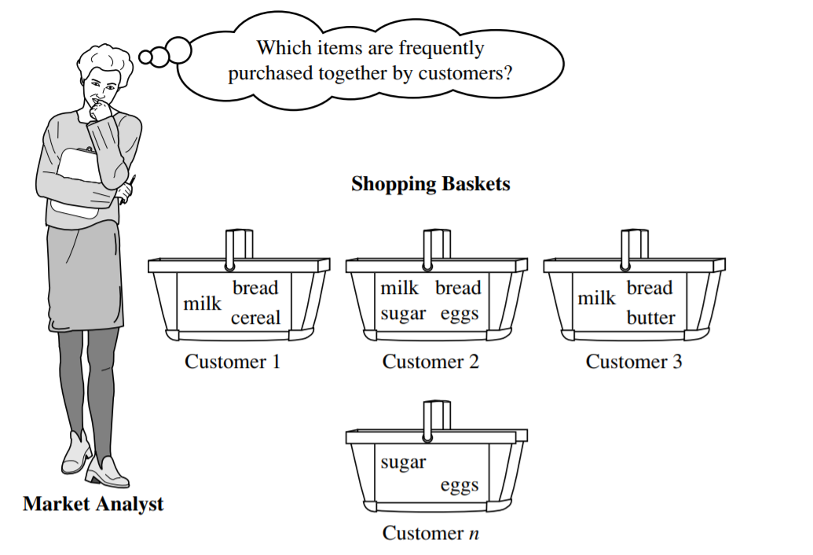
What Is Pattern Discovery?
Pattern discovery: Uncovering patterns from massive data sets
It can answer questions such as:
What products were often purchased together?
What are the subsequent purchases after buying an iPad?
Notes:
Pattern discovery is the process of finding useful patterns or relationships from large data sets.

Slide 4
Pattern Discovery: Why Is It Important?
Foundation for many essential data mining tasks
Association, correlation, and causality analysis
Mining sequential, structural (e.g., sub-graph) patterns
Classification: Discriminative pattern-based analysis
Cluster analysis: Pattern-based subspace clustering
Broad applications
Market basket analysis, cross-marketing, catalog design, sale campaign analysis, Web log analysis, biological sequence analysis
Many types of data: spatiotemporal, multimedia, time-series, and stream data
Notes:
It helps in:
Association, correlation, and causality analysis → finding relationships between data (e.g., items bought together or cause-effect).
Sequential and structural patterns → finding patterns in order (like purchase sequence) or in structures (like graphs).
Classification → using patterns to assign data into categories.
Clustering → grouping similar data based on patterns.
Pattern discovery also has many real-world applications, such as:
Market basket analysis (shopping patterns)
Cross-marketing (selling related products)
Catalog design and sales analysis
Web usage analysis (user behavior online)
Biological data analysis (DNA, sequences)

Slide 5
What Is Frequent Pattern Analysis?
Frequent pattern: a pattern (a set of items, subsequences, substructures, etc.) that occurs frequently in a data set
First proposed by Agrawal, Imielinski, and Swami [AIS93] in the context of frequent itemsets and association rule mining
Motivation: Finding inherent regularities in data
What products were often purchased together?— Bread and butter?!
What are the subsequent purchases after buying a PC?
What kinds of DNA are sensitive to this new drug?
Applications
Basket data analysis, cross-marketing, catalog design, sale campaign analysis, Web log (click stream) analysis, and DNA sequence analysis.
Notes:
What is Frequent Pattern Analysis? (Simple Explanation)
Frequent pattern: A frequent pattern is a group of items or sequences that appear again and again in a dataset. 👉 Example: If many people buy bread and butter together, that is a frequent pattern.
History: This idea was first introduced by Agrawal, Imielinski, and Swami (1993). It is mainly used in:
Frequent itemset mining (finding common item groups)
Association rule mining (finding relationships between items)
Main goal (Motivation): To discover hidden patterns or regular behavior in data.
Examples:
Which products are often bought together? → Bread & butter
What do people buy after purchasing a PC?
Which DNA types react to a certain drug?
Applications: Used in many real-world areas:
Market basket analysis (shopping patterns)
Cross-marketing (selling related products)
Catalog design and sales analysis
Website click analysis
DNA sequence analysis

Slide 6
Basic Concepts: Transactional Database
Transactional Database (TDB)
Each transaction is associated with an identifier, called a TID.
May also have counts associated with each item sold
Tid | Items bought
1 | Beer, Nuts, Diaper
2 | Beer, Coffee, Diaper
3 | Beer, Diaper, Eggs
4 | Nuts, Eggs, Milk
5 | Nuts, Coffee, Diaper, Eggs, Milk

Slide 7

Basic Concepts: k-Itemsets and Their Supports
Itemset: A set of one or more items
k-itemset: An itemset containing k items:
X = {x₁, …, x_{k}}
Ex. {Beer, Nuts, Diaper} is a 3-itemset
Absolute support (count)
sup{X} = occurrences of an itemset X
Ex. sup{Beer} = 3
Ex. sup{Diaper} = 4
Ex. sup{Beer, Diaper} = 3
Ex. sup{Beer, Eggs} = 1
Tid | Items bought
1 | Beer, Nuts, Diaper
2 | Beer, Coffee, Diaper
3 | Beer, Diaper, Eggs
4 | Nuts, Eggs, Milk
5 | Nuts, Coffee, Diaper, Eggs, Milk
Relative support
s{X} = The fraction of transactions that contains X (i.e., the probability that a transaction contains X)
Ex. s{Beer} = 3/5 = 60%
Ex. s{Diaper} = 4/5 = 80%
Ex. s{Beer, Eggs} = 1/5 = 20%
Notes:
Itemset: An itemset is a group of one or more items. Example: {Beer, Nuts}
k-itemset: A k-itemset contains exactly k items. Example: {Beer, Nuts, Diaper} is a 3-itemset.
Absolute support (count): It shows how many times an itemset appears in the dataset. Examples from the table:
sup{Beer} = 3 → Beer appears in 3 transactions
sup{Diaper} = 4
sup{Beer, Diaper} = 3
sup{Beer, Eggs} = 1
Relative support: It shows the percentage (or probability) of transactions that contain the itemset.
Formula idea: Relative support = (occurrences of X) / (total transactions)
Examples:
s{Beer} = 3/5 = 60%
s{Diaper} = 4/5 = 80%
s{Beer, Eggs} = 1/5 = 20%

Slide 8
Basic Concepts: Frequent Itemsets (Patterns)
An itemset (or a pattern) X is frequent if the support of X is no less than a minsup threshold σ
Let σ = 50% (σ: minsup threshold)
for the given 5-transaction dataset
All the frequent 1-itemsets:
Beer: 3/5 (60%); Nuts: 3/5 (60%); Diaper: 4/5 (80%); Eggs: 3/5 (60%)
All the frequent 2-itemsets:
{Beer, Diaper}: 3/5 (60%)
All the frequent 3-itemsets?
None
Tid | Items bought
1 | Beer, Nuts, Diaper
2 | Beer, Coffee, Diaper
3 | Beer, Diaper, Eggs
4 | Nuts, Eggs, Milk
5 | Nuts, Coffee, Diaper, Eggs, Milk
Why do these itemsets (shown on the left) form the complete set of frequent k-itemsets (patterns) for any k?
Observation: We may need an efficient method to mine a complete set of frequent patterns
Notes:
Frequent itemset: An itemset X is called frequent if its support is greater than or equal to a minimum support (minsup) value. Given condition: minsup (σ) = 50% for 5 transactions → An itemset must appear in at least 3 transactions to be frequent.
Frequent 1-itemsets:
Items that appear in ≥ 3 transactions:
Beer: 3/5 = 60%
Nuts: 3/5 = 60%
Diaper: 4/5 = 80%
Eggs: 3/5 = 60%
(All are frequent because they meet the 50% threshold)
Frequent 2-itemsets:
{Beer, Diaper}: 3/5 = 60% (This is the only pair that appears enough times)
Frequent 3-itemsets:
None (No group of 3 items appears in at least 3 transactions)
Key Idea:
We use minsup to filter important patterns.
Only itemsets with high enough support are considered useful.

Slide 9
From Frequent Itemsets to Association Rules
Compared with itemsets, association rules can be more telling
Ex. Diaper → Beer
Buying diapers may likely lead to buying beers
Containing both
Containing diaper
Note: X ∪ Y: the union of two itemsets
The set contains both X and Y
{Beer} ∪ {Diaper}
Beer
Diaper
Containing beer
{Beer} ∪ {Diaper} = {Beer, Diaper}
Notes:
From Frequent Itemsets to Association Rules
Idea: Frequent itemsets only show which items appear together, but association rules show a relationship or implication between items.
Example rule: Diaper → Beer Meaning: If a person buys diapers, they are likely to also buy beer.
Why association rules are better:
Itemsets: just show co-occurrence (e.g., Beer and Diaper appear together)
Rules: show direction and meaning (Diaper leads to Beer)

Slide 10
Association Rules
How do we compute the strength of an association rule X→ Y (Both X and Y are itemsets)?
We first compute the following two metrics, s and c.
Support
Ex. s{Diaper, Beer} = 3/5 = 0.6 (i.e., 60%)
Confidence of
The conditional probability that a transaction containing X also contains Y:
c = sup(X, Y) / sup(X)
Ex. c = sup{Diaper, Beer}/sup{Diaper} = ¾ = 0.75
Tid | Items bought
1 | Beer, Nuts, Diaper
2 | Beer, Coffee, Diaper
3 | Beer, Diaper, Eggs
4 | Nuts, Eggs, Milk
5 | Nuts, Coffee, Diaper, Eggs, Milk
of X ∪ Y
X → Y
In pattern analysis, we are often interested in those rules that dominate the database, and these two metrics ensure the popularity and correlation of X and Y.
Notes:
Association Rules
Goal: To measure how strong a rule like X → Y is (both X and Y are itemsets).
To do this, we use two important metrics: Support and Confidence
1. Support of (X ∪ Y)
It shows how often X and Y appear together in the dataset.
Example: s{Diaper, Beer} = 3/5 = 0.6 (60%) → 60% of transactions contain both items
2. Confidence of (X → Y)
It shows how likely Y appears when X appears
This is a conditional probability
Formula: confidence = sup(X, Y) / sup(X)
Example: c = sup{Diaper, Beer} / sup{Diaper} = 3/4 = 0.75 → 75% of the time, when people buy diapers, they also buy beer

Slide 11
Mining Frequent Itemsets and Association Rules
Tid | Items bought
1 | Beer, Nuts, Diaper
2 | Beer, Coffee, Diaper
3 | Beer, Diaper, Eggs
4 | Nuts, Eggs, Milk
5 | Nuts, Coffee, Diaper, Eggs, Milk
Association rule mining
Given two thresholds: minsup, minconf
Find all of the rules, X → Y (s, c) such that s ≥ minsup and c ≥ minconf
Let minsup = 50%
Freq. 1-itemsets: Beer: 3, Nuts: 3, Diaper: 4, Eggs: 3
Freq. 2-itemsets: {Beer, Diaper}: 3
Let minconf = 50%
Beer → Diaper (60%, 100%)
Diaper → Beer (60%, 75%)
Observations:
Mining association rules and mining frequent patterns are very close problems
Scalable methods are needed for mining large datasets
(Q: Are these all the rules satisfying the two conditions?)
Notes:
Mining Frequent Itemsets and Association Rules
Association rule mining: We are given two thresholds:
minsup (minimum support)
minconf (minimum confidence)
Goal: Find all rules X → Y such that:
support ≥ minsup
confidence ≥ minconf
Given: minsup = 50%
Frequent 1-itemsets: Beer = 3, Nuts = 3, Diaper = 4, Eggs = 3
Frequent 2-itemsets: {Beer, Diaper} = 3
Given: minconf = 50%
From {Beer, Diaper}, we generate rules:
Beer → Diaper Support = 60%, Confidence = 100%
Diaper → Beer Support = 60%, Confidence = 75%
(Both satisfy minsup and minconf)
Observations:
Finding frequent itemsets and association rules are closely related tasks
For large datasets, we need efficient (scalable) algorithms

Slide 12
Challenge: There Are Too Many Frequent Patterns!
A long pattern contains a combinatorial number of sub-patterns
How many frequent itemsets does the following TDB₁ contain (minsup = 1)?
TDB_{1:} T₁: {a₁, …, a₅₀}; T₂: {a₁, …, a₁₀₀}
Let’s have a try
1-itemsets: {a₁}: 2, {a₂}: 2, …, {a₅₀}: 2, {a₅₁}: 1, …, {a₁₀₀}: 1,
2-itemsets: {a₁, a₂}: 2, …, {a₁, a₅₀}: 2, {a₁, a₅₁}: 1 …, …, {a₉₉, a₁₀₀}: 1,
…, …, …, …
99-itemsets: {a₁, a₂, …, a₉₉}: 1, …, {a₂, a₃, …, a₁₀₀}: 1
100-itemset: {a₁, a₂, …, a₁₀₀}: 1
The total number of frequent itemsets:
A too huge set for any one to compute or store!
Notes:
Challenge: Too Many Frequent Patterns
Main problem: A long pattern (many items) can create a very large number of sub-patterns (combinations).
Total number of frequent itemsets:
Total = C(100,1) + C(100,2) + … + C(100,100) = 2¹⁰⁰ − 1
The number of frequent patterns grows exponentially (very fast) It becomes too large to compute or store

Slide 13
Expressing Patterns in Compressed Form: Closed Patterns
How to handle such a challenge?
Solution 1: Closed patterns: A pattern (itemset) X is closed if X is frequent, and there exists no super-pattern Y כ X, with the same support as X
Let Transaction DB TDB₁: T₁: {a₁, …, a₅₀}; T₂: {a₁, …, a₁₀₀}
Suppose minsup = 1. How many closed patterns does TDB₁ contain?
Two: P₁: “{a₁, …, a₅₀}: 2”; P₂: “{a₁, …, a₁₀₀}: 1”
Closed pattern is a lossless compression of frequent patterns
Reduces the # of patterns but does not lose the support information!
You will still be able to say: “{a₂, …, a₄₀}: 2”, “{a₅, a₅₁}: 1”
Notes:
There are too many frequent patterns, so we need a way to reduce them.
Closed Pattern (Solution):
An itemset X is closed if:
It is frequent, and
There is no larger itemset (super-pattern) that has the same support as X
Closed pattern = “Keep only the biggest pattern when support is same”
Step 1: Understand the data
We have 2 transactions:
T₁ = {a₁ … a₅₀}
T₂ = {a₁ … a₁₀₀}
Important:
T₂ contains everything T₁ has + more items
Step 2: Support idea
Items a₁ to a₅₀ appear in both T₁ and T₂ → support = 2
Items a₅₁ to a₁₀₀ appear only in T₂ → support = 1
Step 3: What is NOT closed?
Example:
{a₁, a₂} → support = 2 But this is not closed, because:
A bigger set {a₁ … a₅₀} also has same support = 2
So we ignore smaller ones if a bigger set has same support
Step 4: Find CLOSED patterns
We keep only the largest sets with same support
{a₁ … a₅₀} → support = 2 (No bigger set has support 2 → so it is closed)
{a₁ … a₁₀₀} → support = 1 (No bigger set exists → so it is closed)

Slide 14
Expressing Patterns in Compressed Form: Max-Patterns
Solution 2: Max-patterns: A pattern X is a max-pattern if X is frequent and there exists no frequent super-pattern Y כ X
Difference from close-patterns?
Do not care the real support of the sub-patterns of a max-pattern
Let Transaction DB TDB₁: T₁: {a₁, …, a₅₀}; T₂: {a₁, …, a₁₀₀}
Suppose minsup = 1. How many max-patterns does TDB₁ contain?
One: P: “{a₁, …, a₁₀₀}: 1”
Max-pattern is a lossy compression!
We only know {a₁, …, a₄₀} is frequent
But we do not know the real support of {a₁, …, a₄₀}, …, any more!
Thus in many applications, mining close-patterns is more desirable than mining max-patterns
Notes:
1. What is Max-Pattern?
A pattern X is a max-pattern if:
X is frequent, and
There is no bigger frequent itemset containing X
2. Simple Understanding
Max-pattern = “Largest frequent pattern (nothing bigger is frequent)”
Closed Pattern:
Keeps support information.
Removes only unnecessary smaller sets.
Max Pattern:
Keeps only largest patterns.
Ignores support of smaller ones.
Max-pattern:
{a₁ … a₁₀₀} → only this is max (because no bigger set exists)
7. Why "lossy"?
From max-pattern:
You only know {a₁ … a₄₀} is frequent
But you don’t know its exact support
8. Final Intuition
Closed pattern → compressed but still accurate
Max pattern → more compressed but loses details

Slide 15
ARM-Market Basket Data
Given a set of transactions, find rules that will predict the occurrence of an item based on the occurrences of other items in the transaction
Market-Basket transactions
Example of Association Rules
{Diaper} → {Beer}, {Milk, Bread} → {Eggs, Coke}, {Beer, Bread} → {Milk},
Implication means co-occurrence, not causality!

Slide 16
Example: Frequent Itemset
Itemset
A collection of one or more items
Example: {Milk, Bread, Diaper}
k-itemset
An itemset that contains k items
Support count (σ)
Frequency of occurrence of an itemset
E.g. σ({Milk, Bread, Diaper}) = 2
Support
Fraction of transactions that contain an itemset
E.g. s({Milk, Bread, Diaper}) = 2/5
Frequent Itemset
An itemset whose support is greater than or equal to a minsup threshold

Slide 17
Example: Association Rule
Association Rule
An implication expression of the form X → Y, where X and Y are itemsets
Example: {Milk, Diaper} → {Beer}
Rule Evaluation Metrics
Support (s)
Fraction of transactions that contain both X and Y
Confidence (c)
Measures how often items in Y appear in transactions that contain X
Example:
Notes:
Association Rule:
An association rule is of the form: X → Y Meaning: if X occurs, Y is likely to occur.
Example: {Milk, Diaper} → {Beer}
Support (s)
Definition: Fraction of transactions that contain both X and Y
Here: X ∪ Y = {Milk, Diaper, Beer}
Count: This combination appears in 2 transactions (T3, T4)
So: s = 2 / 5 = 0.4 (40%)
Confidence (c)
Definition: How often Y appears when X appears
Here: X = {Milk, Diaper} appears in 3 transactions (T3, T4, T5) X ∪ Y appears in 2 transactions
So: c = 2 / 3 ≈ 0.67 (67%)
40% of all transactions contain Milk, Diaper, and Beer When people buy Milk and Diaper, 67% of the time they also buy Beer

Slide 18
Association Rule Mining Task
Given a set of transactions T, the goal of association rule mining is to find all rules having
support ≥ minsup threshold
confidence ≥ minconf threshold
Brute-force approach:
List all possible association rules
Compute the support and confidence for each rule
Prune rules that fail the minsup and minconf thresholds
⇒ Computationally prohibitive!
Notes:
Association Rule Mining Task
Given a set of transactions, find all rules X → Y such that:
support ≥ minsup
confidence ≥ minconf
Brute-force Approach:
Generate all possible rules (try every possible combination of items)
Compute support and confidence for each rule
Remove (prune) rules that do not satisfy minsup and minconf
Problem:
The number of possible rules is very large
Checking all of them takes too much time and computation

Slide 19
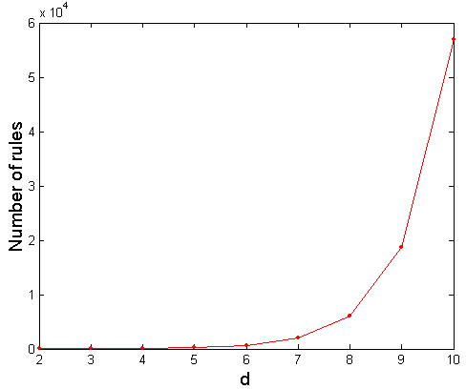
Computational Complexity
Given d unique items:
Total number of itemsets = 2^{d}
Total number of possible association rules:
If d=6, R = 602 rules
Notes:
Computational Complexity
Suppose we have d unique items
Number of itemsets:
Total possible itemsets = 2ᵈ
Reason: each item can be either present or not present
Number of association rules:
Total rules = 3ᵈ − 2ᵈ⁺¹ + 1
This number grows very fast as d increases.

Slide 20
Mining Association Rules
Example of Rules:
{Milk,Diaper} → {Beer} (s=0.4, c=0.67) {Milk,Beer} → {Diaper} (s=0.4, c=1.0)
{Diaper,Beer} → {Milk} (s=0.4, c=0.67)
{Beer} → {Milk,Diaper} (s=0.4, c=0.67) {Diaper} → {Milk,Beer} (s=0.4, c=0.5)
{Milk} → {Diaper,Beer} (s=0.4, c=0.5)
Observations: total transactions = 5
All the above rules are binary partitions of the same itemset: {Milk, Diaper, Beer} = 2
Rules originating from the same itemset have identical support but can have different confidence
Thus, we may decouple the support and confidence requirements

Slide 21
Mining Association Rules
Two-step approach:
Frequent Itemset Generation
Generate all itemsets whose support ≥ minsup
Rule Generation
Generate high confidence rules from each frequent itemset, where each rule is a binary partitioning of a frequent itemset
Frequent itemset generation is still computationally expensive
Notes:
Step 1: Frequent Itemset Generation
Find all itemsets whose support ≥ minsup
These are called frequent itemsets
Step 2: Rule Generation
From each frequent itemset, create rules X → Y
Keep only rules with high confidence (≥ minconf)
Key Idea:
First find frequent patterns (support)
Then generate strong rules (confidence)
Even finding frequent itemsets is still computationally expensive

Slide 22
Frequent Itemset Generation
Given d items, there are 2^{d} possible candidate itemsets
Notes:
Frequent Itemset Generation
If there are d items, total possible itemsets = 2ᵈ
The diagram shows all possible combinations:
Single items: A, B, C…
Pairs: AB, AC…
Triples: ABC…
Up to all items: ABCDE
Problem:
Number of combinations grows very fast
Checking all of them is too slow

Slide 23
Frequent Itemset Generation
Brute-force approach: (N TID, Itemset w, M Listof candiates)
Each itemset in the lattice is a candidate frequent itemset
Count the support of each candidate by scanning the database
Match each transaction against every candidate
Complexity ~ O(NMw) => Expensive since M = 2^{d} !!!
Notes:
Basic Idea:
Consider all possible itemsets as candidates
Then check which ones are frequent
Steps:
Generate all candidates
Every itemset in the lattice (all combinations) is a candidate
Count support
Scan the database
Count how many times each candidate appears
Match process
Compare each transaction with every candidate
Meaning of symbols:
N = number of transactions
M = number of candidate itemsets
w = size (length) of itemset
Complexity:
Time ≈ O(N × M × w)
Since M = 2ᵈ, it becomes very large

Slide 24
Frequent Itemset Generation Policy
Reduce the number of candidates (M), d items
Complete search: M=2^{d}
Use pruning techniques to reduce M
Reduce the number of transactions (N)
Reduce size of N as the size of itemset increases
Used by DHP and vertical-based mining algorithms
Reduce the number of comparisons (NM)
Use efficient data structures to store the candidates or transactions
No need to match every candidate against every transaction
Notes:
1. Reduce number of candidates (M)
Total candidates = 2ᵈ (very large)
Use pruning → remove unnecessary itemsets early (do not check all combinations)
2. Reduce number of transactions (N)
As itemsets get larger, fewer transactions contain them
So we can ignore some transactions
Used in algorithms like DHP, vertical mining
3. Reduce number of comparisons (N × M)
Avoid checking every candidate with every transaction
Use efficient data structures (like trees, lists)

Slide 25
Reducing Number of Candidates
Apriori Principle:
If an itemset is frequent, then all of its subsets must also be frequent
Apriori principle holds due to the following property of the support measure:
Support of an itemset never exceeds the support of its subsets
This is known as the anti-monotone property of support
Notes:
Apriori Principle (Main Idea):
If an itemset is frequent, then all of its subsets must also be frequent
Simple Example:
If {A, B, C} is frequent → then:
{A, B}, {A, C}, {B, C} must also be frequent
Also {A}, {B}, {C} must be frequent
Important Rule:
If any subset is not frequent, then the larger itemset cannot be frequent
Example:
{A, B} is not frequent → then {A, B, C} will also NOT be frequent → so we skip checking it
Why this works (Support property):
If X ⊆ Y, then support(X) ≥ support(Y)
Meaning:
Bigger itemsets appear less or equal times
Support never increases when we add more items
Key Term:
This is called anti-monotone property of support

Slide 26
Illustrating Apriori Principle (Pruning)
Found to be Infrequent
Pruned supersets
Notes:
Suppose {A, B} is found to be infrequent (low support)
Apply Apriori Principle:
Since {A, B} is not frequent → any larger itemset containing {A, B} will also be infrequent
So we prune (remove):
{A, B, C}
{A, B, D}
{A, B, E}
{A, B, C, D}
{A, B, C, E}
{A, B, D, E}
{A, B, C, D, E}
(All supersets of AB are removed)

Slide 27
Illustrating Apriori Principle
Items (1-itemsets)
Minimum Support = 3
Total Items = 6
If every subset is considered,
⁶C₁ + ⁶C₂ + ⁶C₃
6 + 15 + 20 = 41
With support-based pruning,
6 + 6 + 1 = 13
Notes:
Step 3: Apply Apriori (Pruning)
Keep only items with support ≥ 3:
Bread, Milk, Diaper, Beer → Frequent
Coke, Eggs → Remove (infrequent)
Step 4: Candidate Reduction
Without pruning:
Total subsets = 6C1 + 6C2 + 6C3 = 6 + 15 + 20 = 41
With pruning:
Only use frequent items (4 items now)
So:
1-itemsets = 4
2-itemsets = 6
3-itemsets = 4 → Total = 13
Remove infrequent items early (Coke, Eggs) Do not generate combinations using them This greatly reduces number of candidates

Slide 28
Illustrating Apriori Principle
Items (1-itemsets)
Minimum Support = 3
If every subset is considered,
⁶C₁ + ⁶C₂ + ⁶C₃
6 + 15 + 20 = 41
With support-based pruning,
6 + 6 + 1 = 13

Slide 29
Illustrating Apriori Principle
Items (1-itemsets)
Pairs (2-itemsets)
(No need to generate candidates involving Coke or Eggs)
Minimum Support = 3
If every subset is considered,
⁶C₁ + ⁶C₂ + ⁶C₃
6 + 15 + 20 = 41
With support-based pruning,
6 + 6 + 1 = 13

Slide 30
Illustrating Apriori Principle
Items (1-itemsets)
Pairs (2-itemsets)
(No need to generate candidates involving Coke or Eggs)
Minimum Support = 3
If every subset is considered,
⁶C₁ + ⁶C₂ + ⁶C₃
6 + 15 + 20 = 41
With support-based pruning,
⁶C₁ + ⁴C₂ + 1
6 + 6 + 1 = 13

Slide 31
Illustrating Apriori Principle
Items (1-itemsets)
Pairs (2-itemsets)
(No need to generate candidates involving Coke or Eggs)
Minimum Support = 3
Triplets (3-itemsets)
If every subset is considered,
⁶C₁ + ⁶C₂ + ⁶C₃
6 + 15 + 20 = 41
With support-based pruning,
⁶C₁ + ⁴C₂ + 1
6 + 6 + 1 = 13

Slide 32
Apriori Principle
Items (1-itemsets)
Pairs (2-itemsets)
(No need to generate candidates involving Coke or Eggs)
Minimum Support = 3
Triplets (3-itemsets)
If every subset is considered,
⁶C₁ + ⁶C₂ + ⁶C₃
6 + 15 + 20 = 41
With support-based pruning,
6 + 6 + 1 = 13
Item Set
{Beer, Diaper, Milk} (2)
{Beer, Bread, Diaper} (2)
{Bread, Diaper, Milk} (3)
{Beer, Bread, Milk} (1)

Slide 33
Apriori Algorithm
F_{k}: frequent k-itemsets
L_{k}: candidate k-itemsets
Algorithm
Let k=1
Generate F₁ = {frequent 1-itemsets}
Repeat until F_{k} is empty
Candidate Generation: Generate L_{k+1} from F_{k}
Candidate Pruning: Prune candidate itemsets in L_{k+1} containing subsets of length k that are infrequent
Support Counting: Count the support of each candidate in L_{k+1} by scanning the DB
Candidate Elimination: Eliminate candidates in L_{k+1} that are infrequent, leaving only those that are frequent => F_{k+1}

Slide 34
Aprioi in Details
How to generate candidates?
Step 1: Self-joining L_{k}
Two (k-1)-itemsets l₁ and l₂ can join only if the first (k-2) items are same and for the last term l₁[k-1]<l₂[k-1]
Example: L_{k}={AB, AC, AE, CE}
AB and AC → ABC (Lexiographic Order)
AB and AE → ABE
AC and AE → ACE
Step 2: Pruning
Use of Apriori property
A candidate answer set can be safely pruned , if it contains infrequent subset
Notes:
Goal: How to generate next candidates?
We want to go from:
L₃ (3-itemsets) → L₄ (4-itemsets)
Step 1: Self-Joining (Combine sets)
We combine itemsets that are almost same
Rule:
Two itemsets can join if:
First (k−2) items are same
Example:
L₃ = {ABC, ABD, ACD, ACE, BCD}
Join:
ABC + ABD → ABCD (same first two items AB)
ACD + ACE → ACDE
So candidates:
ABCD
ACDE
Step 2: Pruning (Very important)
Now we check: 👉 Are all subsets of these candidates frequent?
Check ABCD:
Subsets:
ABC ✅ (in L₃)
ABD ✅
ACD ✅
BCD ✅
→ All exist → KEEP ABCD
Check ACDE:
Subsets:
ACD ✅
ACE ✅
CDE ❓
ADE ❌ (NOT in L₃)
→ One subset (ADE) is missing → REMOVE ACDE
Final Result:
L₄ = {ABCD}

Slide 35
Apriori in Details (Contd.)
How to generate candidates?
Step 1: self-joining L_{k}
Step 2: pruning
Example of Candidate-generation
L₃={ABC, ABD, ACD, ACE, BCD}
Self-joining: L₃*L₃
ABCD from ABC and ABD
ACDE from ACD and ACE
Pruning:
ACDE is removed because ADE is not in L₃
L₄ = {ABCD}

Slide 36
Candidate Generation: Brute-force method

Slide 37
Candidate Generation: Merge Fk-1 and F1 itemsets

Slide 38
Candidate Generation: Fk-1 x Fk-1 Method

Slide 39
Candidate Generation: F_{k-1} x F_{k-1} Method
Merge two frequent (k-1)-itemsets if their first (k-2) items are identical
F₃ = {ABC,ABD,ABE,ACD,BCD,BDE,CDE}
Merge(ABC, ABD) = ABCD
Merge(ABC, ABE) = ABCE
Merge(ABD, ABE) = ABDE
Do not merge(ABD,ACD) because they share only prefix of length 1 instead of length 2

Slide 40
Candidate Pruning
Let F₃ = {ABC,ABD,ABE,ACD,BCD,BDE,CDE} be the set of frequent 3-itemsets
L₄ = {ABCD, ABCE, ABDE} is the set of candidate 4-itemsets generated (from previous slide)
Candidate pruning
Prune ABCE because ACE and BCE are infrequent
Prune ABDE because ADE is infrequent
After candidate pruning: L₄ = {ABCD}

Slide 41
Alternate F_{k-1} x F_{k-1} Method
Merge two frequent (k-1)-itemsets if the last (k-2) items of the first one is identical to the first (k-2) items of the second.
Using prefix and suffix
F₃ = {ABC,ABD,ABE,ACD,BCD,BDE,CDE}
Merge(ABC, BCD) = ABCD
Merge(ABD, BDE) = ABDE
Merge(ACD, CDE) = ACDE
Merge(BCD, CDE) = BCDE
Notes:
suffix of first itemset = prefix of second itemset
Join two itemsets if:
Last (k−2) items of first = First (k−2) items of second

Slide 42
Candidate Pruning for Alternate F_{k-1} x F_{k-1} Method
Let F₃ = {ABC,ABD,ABE,ACD,BCD,BDE,CDE} be the set of frequent 3-itemsets
L₄ = {ABCD,ABDE,ACDE,BCDE} is the set of candidate 4-itemsets generated (from previous slide)
Candidate pruning
Prune ABDE because ADE is infrequent
Prune ACDE because ACE and ADE are infrequent
Prune BCDE because BCE
After candidate pruning: L₄ = {ABCD}

Slide 43
Apriori Principle
Items (1-itemsets)
Pairs (2-itemsets)
(No need to generate candidates involving Coke or Eggs)
Minimum Support = 3
Triplets (3-itemsets)
Use of F_{k-1}xF_{k-1} method for candidate generation results in
only one 3-itemset. This is eliminated after the support counting step.

Slide 44
Support Counting of Candidate Itemsets
Scan the database of transactions to determine the support of each candidate itemset
Must match every candidate itemset against every transaction, which is an expensive operation

Slide 45
Support Counting of Candidate Itemsets
To reduce number of comparisons, store the candidate itemsets in a hash structure
Instead of matching each transaction against every candidate, match it against candidates contained in the hashed buckets
Notes:
Apriori improves support counting efficiency by storing candidate itemsets in a hash structure, so instead of comparing every transaction with all candidates, each transaction is only compared with a smaller set of relevant candidates grouped into hash buckets, which significantly reduces the number of comparisons and speeds up the mining process.

Slide 46
Support Counting: Hash Tree
Suppose you have 15 candidate itemsets of length 3:
{1 4 5}, {1 2 4}, {4 5 7}, {1 2 5}, {4 5 8}, {1 5 9}, {1 3 6}, {2 3 4}, {5 6 7}, {3 4 5}, {3 5 6}, {3 5 7}, {6 8 9}, {3 6 7}, {3 6 8}
How many of these itemsets are supported by transaction (1,2,3,5,6)?

Slide 47
Support Counting- Using Hash Tree
Suppose we have 15 candidate itemsets of length 3: Branching 0, 1, 2 = P mod 3
{1 4 5}, {1 2 4}, {4 5 7}, {1 2 5}, {4 5 8}, {1 5 9}, {1 3 6}, {2 3 4}, {5 6 7}, {3 4 5}, {3 5 6}, {3 5 7}, {6 8 9}, {3 6 7}, {3 6 8}
We need:
Hash function
Max leaf size: max number of itemsets stored in a leaf node (if number of candidate itemsets exceeds max leaf size, split the node)
{1, 2, 3, 4, 5, 6, 7, 8, 9}
2
0
0
Hash function
1
2 3 4
5 6 7
1
0
2
3,6,9
2
1,4,7
1 4 5
3 4 5
3 5 6
3 5 7
6 8 9
3 6 7
3 6 8
1 3 6
2,5,8
1
2
0
1 2 4
4 5 7
1 2 5
4 5 8
1 5 9

Slide 48
Subset Operation- Using a Hash Tree
Hash Function
Candidate Hash Tree
1,4,7
3,6,9
1
0
2
2,5,8
2 3 4
5 6 7
1 4 5
1 3 6
3 4 5
3 5 6
3 6 7
Hash on 1, 4 or 7
3 5 7
3 6 8
1 2 4
1 5 9
6 8 9
1 2 5
4 5 7
4 5 8

Slide 49
Subset Operation- Using a Hash Tree
Hash Function
Candidate Hash Tree
1,4,7
3,6,9
2,5,8
2 3 4
5 6 7
1 4 5
1 3 6
3 4 5
3 5 6
3 6 7
Hash on 2, 5 or 8
3 5 7
3 6 8
1 2 4
1 5 9
6 8 9
1 2 5
4 5 7
4 5 8

Slide 50
Subset Operation- Using a Hash Tree
Hash Function
Candidate Hash Tree
1,4,7
3,6,9
2,5,8
2 3 4
5 6 7
1 4 5
1 3 6
3 4 5
3 5 6
3 6 7
Hash on 3, 6 or 9
3 5 7
3 6 8
1 2 4
1 5 9
6 8 9
1 2 5
4 5 7
4 5 8

Slide 51
Subset Operation- Using a Hash Tree
1 2 3 5 6
transaction
Hash Function
1 +
2 3 5 6
2 +
3 5 6
1,4,7
3,6,9
3 +
5 6
2,5,8
2 3 4
5 6 7
1 4 5
1 3 6
3 4 5
3 5 6
3 6 7
3 5 7
3 6 8
1 2 4
1 2 5
1 5 9
6 8 9
4 5 7
4 5 8

Slide 52
Support Counting Using a Hash Tree
1 2 3 5 6
transaction
Hash Function
1 +
2 3 5 6
2 +
3 5 6
1,4,7
3,6,9
1 2 +
3 5 6
3 +
5 6
2,5,8
1 3 +
5 6
2 3 4
1 5 +
6
5 6 7
1 4 5
1 3 6
3 4 5
3 5 6
3 6 7
3 5 7
3 6 8
1 2 4
1 2 5
1 5 9
6 8 9
4 5 7
4 5 8

Slide 53
Support Counting Using a Hash Tree
1 2 3 5 6
transaction
Hash Function
1 +
2 3 5 6
2 +
3 5 6
1,4,7
3,6,9
1 2 +
3 5 6
3 +
5 6
2,5,8
1 3 +
5 6
2 3 4
1 5 +
6
5 6 7
1 4 5
1 3 6
3 4 5
3 5 6
3 6 7
3 5 7
3 6 8
1 2 4
1 2 5
1 5 9
6 8 9
4 5 7
4 5 8
Match transaction against 11 out of 15 candidates

Slide 54
Rule Generation
Given a frequent itemset L, find all non-empty subsets f ⊂ L such that f → L – f satisfies the minimum confidence requirement
If {A,B,C,D} is a frequent itemset, candidate rules:
ABC →D, ABD →C, ACD →B, BCD →A, A →BCD, B →ACD, C →ABD, D →ABC AB →CD, AC → BD, AD → BC, BC →AD, BD →AC, CD →AB,
If |L| = k, then there are 2^{k} – 2 candidate association rules (ignoring L → ∅ and ∅ → L)

Slide 55
Rule Generation
In general, confidence c does not have an anti-monotone property
c(ABC →D) can be larger or smaller than c(AB →D)
But confidence of rules generated from the same itemset has an anti-monotone property
E.g., Suppose {A,B,C,D} is a frequent 4-itemset: c(ABC → D) ≥ c(AB → CD) ≥ c(A → BCD)
Confidence is anti-monotone w.r.t. number of items on the RHS of the rule
Notes:
Confidence does NOT always behave nicely (anti-monotone).
But in some special case (same itemset) it DOES behave nicely.
In general, confidence does not satisfy anti-monotonicity since adding items to the antecedent may increase or decrease confidence. However, for rules generated from the same frequent itemset, confidence follows an anti-monotone property with respect to the RHS, meaning as the number of items on the RHS increases, the confidence decreases, i.e., $c\left(ABC→D\right)≥c\left(AB→CD\right)≥c\left(A→BCD\right)$

Slide 56
Interestingness Measure: Correlations (Lift)
play basketball ⇒ eat cereal [40%, 66.7%] is misleading
The overall % of students eating cereal is 75% > 66.7%.
play basketball ⇒ not eat cereal [20%, 33.3%] is more accurate, although with lower support and confidence
Measure of dependent/correlated events: lift
 | Basketball | Not basketball | Sum (row)
Cereal | 2000 | 1750 | 3750
Not cereal | 1000 | 250 | 1250
Sum(col.) | 3000 | 2000 | 5000
Notes:
Lift measures REAL relationship between two items
“Do A and B occur together MORE than expected or not?”
Lift valueMeaning
> 1 Positive relation (good rule ✅)
= 1 No relation (independent)
< 1 Negative relation (misleading ❌)
Lift is an interestingness measure that evaluates the strength of association between two items by comparing observed co-occurrence with expected independence. It is defined as $\frac{P\left(A∩B\right)}{P\left(A\right)P\left(B\right)}$. If lift > 1, the items are positively correlated; if lift = 1, they are independent; and if lift < 1, they are negatively correlated. In the example, lift(Basketball, Cereal) = 0.89 shows a misleading rule, while lift(Basketball, Not Cereal) = 1.33 indicates a meaningful association.

Slide 57
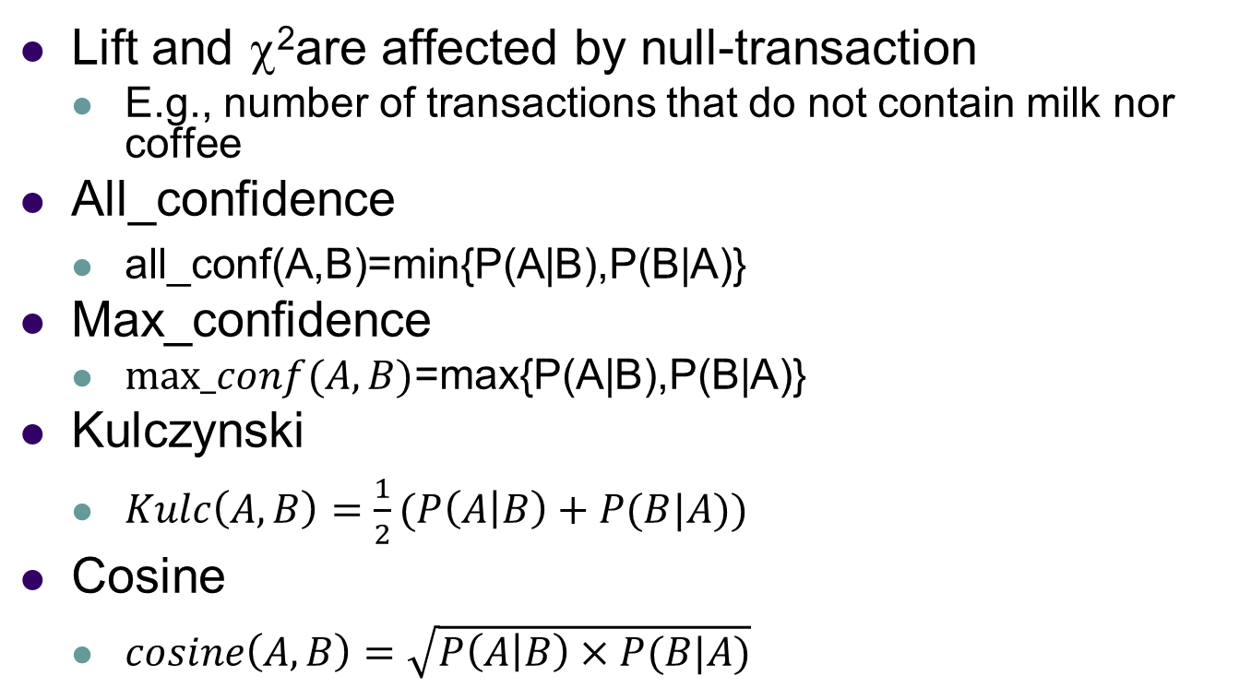
Are lift and χ² Good Measures of Correlation?
Lift and χ²are affected by null-transaction
E.g., number of transactions that do not contain milk nor coffee
All_confidence
$\text{all}\text{_}\text{conf}\text{(}\text{A}\text{,}\text{B}\text{)=}\text{min}\text{\{}\text{P}\text{(}\text{A}\text{|}\text{B}\text{),}\text{P}\text{(}\text{B}\text{|}\text{A}\text{)\}}$
Max_confidence
$max_conf(A,B)$=$\text{m}\text{ax}\text{\{}\text{P}\text{(}\text{A}\text{|}\text{B}\text{),}\text{P}\text{(}\text{B}\text{|}\text{A}\text{)\}}$
Kulczynski
$Kulc\left(A,B\right)=\frac{1}{2}(P\left(A | B\right)+P(B|A))$
Cosine
$cosine\left(A,B\right)=\sqrt{P\left(A | B\right)×P(B|A)}$
Notes:
Lift and χ² are not always reliable measures because they are affected by null-transactions, which do not contain either item and can distort correlation. Alternative measures such as all_confidence (minimum of P(A|B) and P(B|A)), max_confidence (maximum of both), Kulczynski (average of both), and cosine (geometric mean) provide more balanced and stable evaluation of association between items.
All_confidence: Take minimum confidence, Gives strictest measure Avoids overestimation
Max_confidence: Take maximum confidence, Shows strongest direction of rule.
Kulczynski (Kulc): Average of both directions, Balanced measure.
Cosine: Uses geometric mean, Stable and symmetric
Lift is useful but not always reliable
Better to use Kulc or Cosine for accurate correlation

Slide 58
Partition: Scan Database Only Twice
Any itemset that is potentially frequent in DB must be frequent in at least one of the partitions of DB
Scan 1: partition database and find local frequent patterns
Scan 2: consolidate global frequent patterns
A. Savasere, E. Omiecinski and S. Navathe, VLDB’95
Notes:
👉 “Scan database only twice”
Normally Apriori: ❌ Scans database many times 👉 Very slow for large data
Partition method: ✅ Only 2 scans needed
“If an itemset is globally frequent, it must be frequent in at least one partition”
🔸 Meaning:
Divide database into small parts (partitions)
If an itemset is truly frequent overall, 👉 it must appear frequently in at least one part
Scan 1 (Local Frequent):
For each partition:
Find local frequent itemsets
Use same min support (adjusted locally)
Combine Candidates:
Collect all local frequent itemsets
This becomes global candidates
Scan 2 (Global Counting):
👉 Scan whole DB again 👉 Count support of these candidates
Partition algorithm divides the database into smaller partitions and finds local frequent itemsets in each partition during the first scan. Since any globally frequent itemset must be frequent in at least one partition, all local frequent itemsets are combined to form candidate sets. In the second scan, these candidates are checked against the entire database to find globally frequent itemsets, thus reducing database scans to only two and improving efficiency.

Slide 59
DHP: Reduce the Number of Candidates
A k-itemset whose corresponding hashing bucket count is below the threshold cannot be frequent
Candidates: a, b, c, d, e
Hash entries
{ab, ad, ae}
{bd, be, de}
…
Frequent 1-itemset: a, b, d, e
ab is not a candidate 2-itemset if the sum of count of {ab, ad, ae} is below support threshold
(J. Park, M. Chen, and P. Yu. An effective hash-based algorithm for mining association rules. SIGMOD’95)
count
itemsets
35
{ab, ad, ae}
88
{bd, be, de}
...
...
102
{yz, qs, wt}
Hash Table
Notes:
“If a hash bucket count is below support threshold → itemsets in that bucket cannot be frequent
DHP (Direct Hashing and Pruning) reduces the number of candidate itemsets by hashing them into buckets and counting occurrences. If the count of a bucket is less than the minimum support threshold, then all itemsets mapped to that bucket are pruned since they cannot be frequent. This approach helps eliminate many candidates early and improves the efficiency of frequent itemset mining.

Slide 60
Transaction Reduction
A transaction that does not contain any frequent k-itemsets cannot contain any frequent (k+1)-itemsets
Such transaction can be removed
Notes:
“If a transaction does NOT contain any frequent k-itemset → it cannot contain any frequent (k+1)-itemset”

Slide 61
Sampling for Frequent Patterns
Select a sample of original database, mine frequent patterns within sample using Apriori
Scan database once to verify frequent itemsets found in sample, only borders of closure of frequent patterns are checked
Example: check abcd instead of ab, ac, …, etc.
Scan database again to find missed frequent patterns
H. Toivonen. Sampling large databases for association rules. In VLDB’96
Notes:
Sampling for frequent pattern mining selects a small portion of the database and applies the Apriori algorithm to find frequent itemsets quickly. These itemsets are then verified by scanning the full database, checking mainly the border itemsets instead of all combinations. Finally, another scan is performed to find any missed frequent patterns, making the approach faster while maintaining accuracy.

Slide 62
DIC: Reduce Number of Scans
Once both A and D are determined frequent, the counting of AD begins
Once all length-2 subsets of BCD are determined frequent, the counting of BCD begins
Transactions
1-itemsets
2-itemsets
…
1-itemsets
2-items
3-items
Notes:
DIC reduces scans by dynamically starting the counting of larger itemsets as soon as their subsets are found frequent, instead of waiting for complete passes.

Slide 63
Rule Generation - Apriori Algorithm
Lattice of rules
Low Confidence Rule
Pruned Rules

Slide 64
Reading Material
Class Lecture
Text Book: (V. Kumar et al.) Chapter 6

Slide 65
Acknowledgements
Vipin Kumar et al. (University of Minnesota-Twin Cities)
Jiawei Han (University of Iillinoi-UC) (CS412)

